Slide 1
Hybrid techniques
Scheduling algorithm

Slide 2
ROUND ROBIN METHOD
The name of this algorithm comes from the round-robin principle, where each person gets an equal share of something in turns.
It is the oldest, simplest scheduling algorithm, which is mostly used for multitasking.
In Round-robin scheduling, each ready task runs turn by turn only in a cyclic queue for a limited time slice.
This algorithm also offers starvation free execution of processes.

Slide 3
CHARACTERISTICS
Round robin is a pre-emptive algorithm
The CPU is shifted to the next process after fixed interval time, which is called time quantum/time slice.
The process that is preempted is added to the end of the queue.
Round robin is a hybrid model which is clock-driven
Time slice should be minimum, which is assigned for a specific task that needs to be processed. However, it may differ OS to OS.
It is a real time algorithm which responds to the event within a specific time limit.
Round robin is one of the oldest, fairest, and easiest algorithm.

Slide 4

EXAMPLE
Process Queue | Burst time
P1 | 4
P2 | 3
P3 | 5

Slide 5
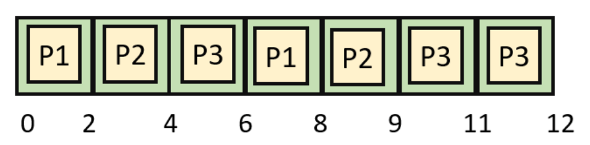
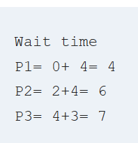
GANTT CHART

Slide 6
Round Robin Scheduling with different arrival times
How to compute these process requests:-
Take the process which occurs first and start executing the process(for quantum time only).
Check if any other process request has arrived. If a process request arrives during the quantum time in which another process is executing, then add the new process to the Ready queue
After the quantum time has passed, check for any processes in the Ready queue. If the ready queue is empty then continue the current process. If the queue not empty and the current process is not complete, then add the current process to the end of the ready queue.
Take the first process from the Ready queue and start executing it (same rules)
Repeat all steps above from 2-4
If the process is complete and the ready queue is empty then the task is complete
Completion Time: the time taken for a process to complete.
Turn Around Time: total time the process exists in the system. (completion time – arrival time).
Waiting Time: total time waiting for their complete execution. (turn around time – burst time )

Slide 7
If the CPU scheduling policy is Round Robin with time quantum = 2 unit, calculate the average waiting time and average turn around time.
Process Id | Arrival time | Burst time
P1 | 0 | 5
P2 | 1 | 3
P3 | 2 | 1
P4 | 3 | 2
P5 | 4 | 3

Slide 8
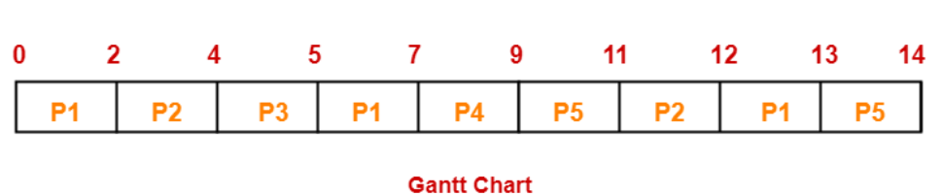
QUEUE STATUS
P1 | P2 | P3 | P1 | P4 | P5 | P2 | P1 | P5
Turn Around time = Exit time – Arrival time
Waiting time = Turn Around time – Burst time
Process Id | Exit time | Turn Around time | Waiting time
P1 | 13 | 13 – 0 = 13 | 13 – 5 = 8
P2 | 12 | 12 – 1 = 11 | 11 – 3 = 8
P3 | 5 | 5 – 2 = 3 | 3 – 1 = 2
P4 | 9 | 9 – 3 = 6 | 6 – 2 = 4
P5 | 14 | 14 – 4 = 10 | 10 – 3 = 7
Average Turn Around time
= (13 + 11 + 3 + 6 + 10) / 5 = 43 / 5 = 8.6 unit
Average waiting time
= (8 + 8 + 2 + 4 + 7) / 5 = 29 / 5 = 5.8 unit

Slide 9
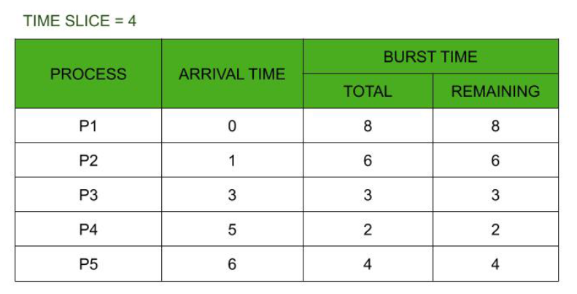
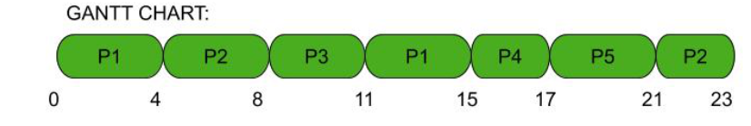
EXAMPLE

